Slide 1



SMART INDIA HACKATHON 2025
TITLE PAGE
Problem Statement ID – SIH25049
Problem Statement Title- AI Driven Public Health Chatbot For Diseases Awareness
Theme-
PS Category- Software
Team ID- IT_10
Team Name :- Ignite Minds
Medtech/Biotech/Healthtech

Slide 2

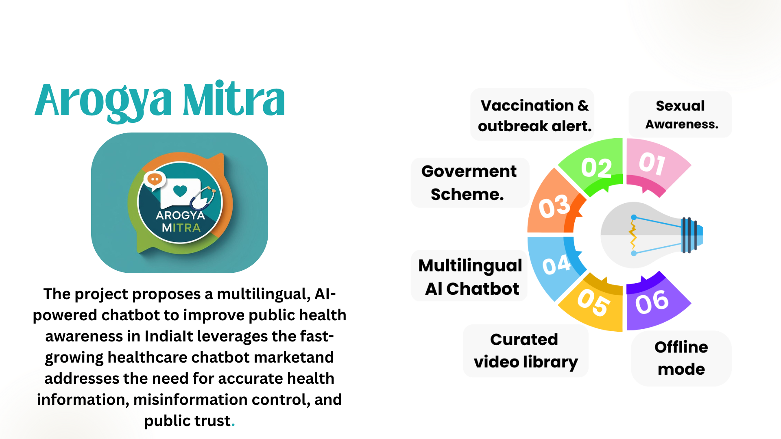
Ignite Minds
AI Driven Public Health Chatbot
for Disease Awareness
Proposed Solution: Multilingual AI Chatbot for Sexual Health Awareness and Disease Prevention in Rural and Semi-Urban India
@SIH Idea submission- Template
Notes:
1.7.2013
null
‹#›

Slide 3

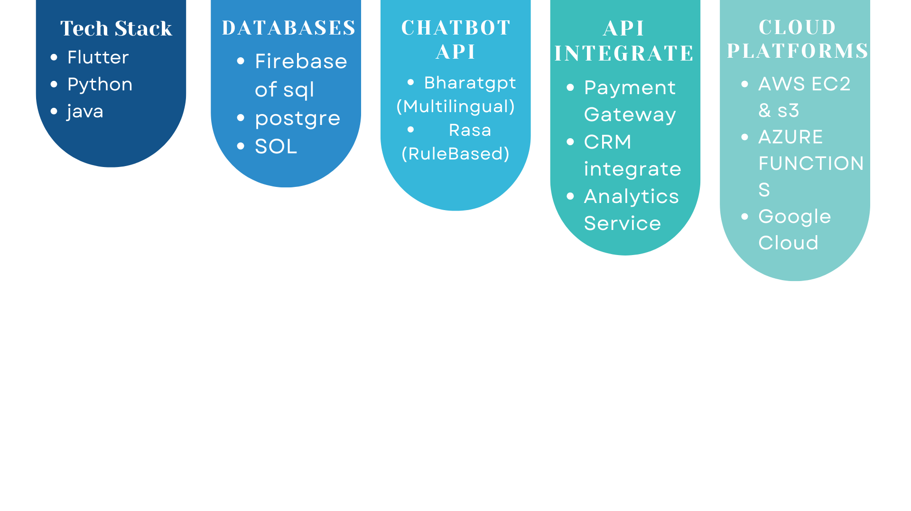
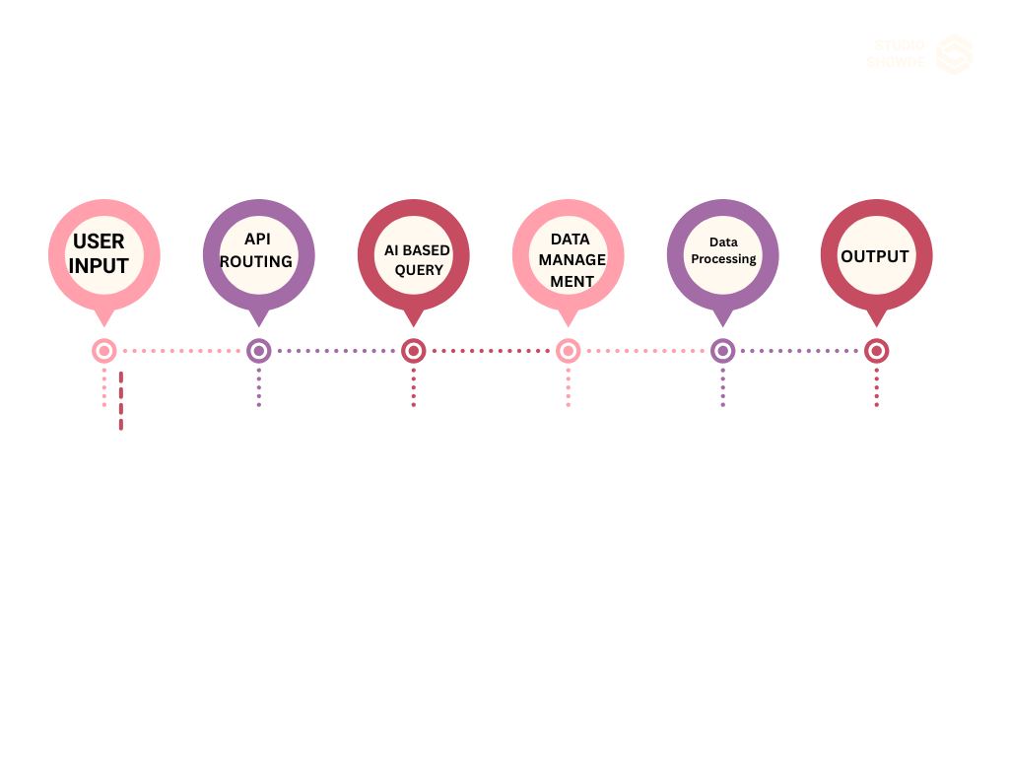
Ignite Minds
TECHNICAL APPROACH
@SIH Idea submission- Template
Notes:
1.7.2013
null
‹#›

Slide 4
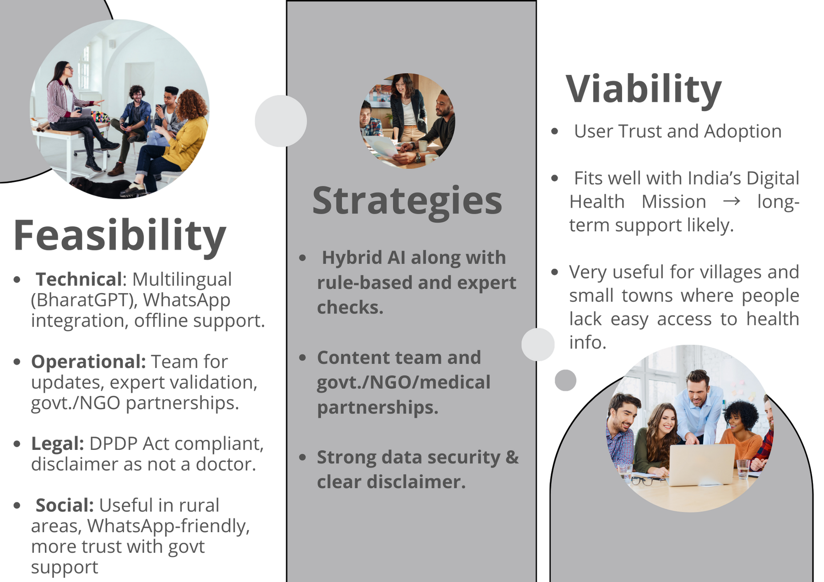

FEASIBILITY AND VIABILITY
Ignite
Minds
@SIH Idea submission- Template
Notes:
1.7.2013
null
‹#›

Slide 5

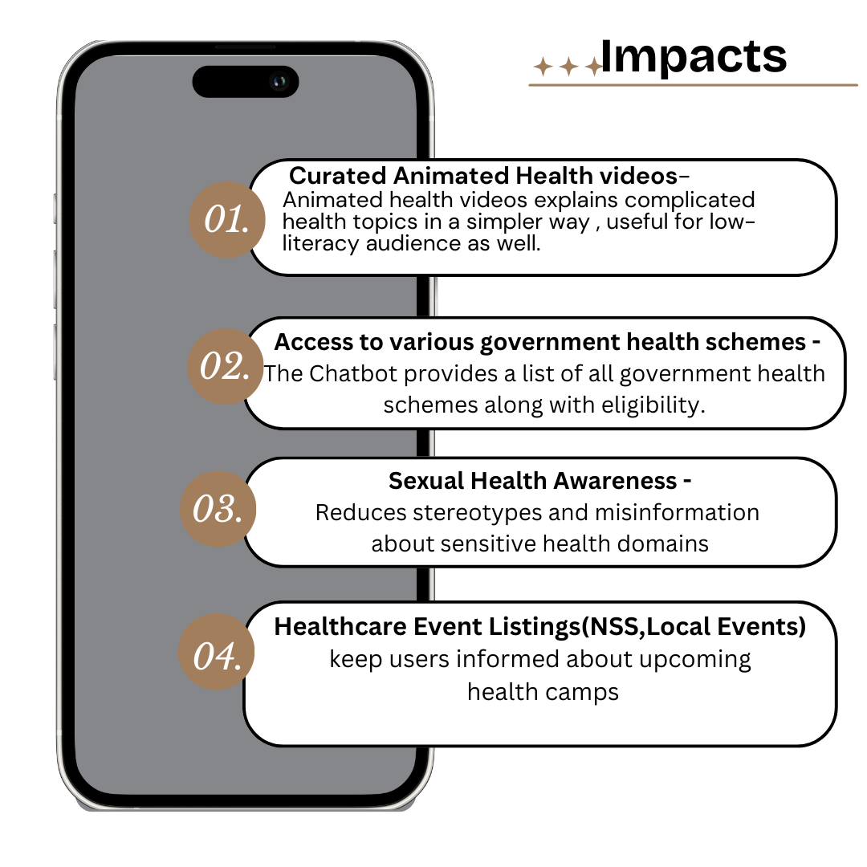

IMPACT AND BENEFITS
Ignite Minds
@SIH Idea submission- Template
Notes:
1.7.2013
null
‹#›

Slide 6

RESEARCH AND REFERENCES
Your Team Name
Details / Links of the reference and research work
@SIH Idea submission- Template
Notes:
1.7.2013
null
‹#›

Slide 7

IMPORTANT INSTRUCTIONS
Please ensure below pointers are met while submitting the Idea PPT:
Kindly keep the maximum slides limit up to six (6). ( Including the title slide)
Try to avoid paragraphs and post your idea in points /diagrams / Infographics /pictures
Keep your explanation precise and easy to understand
Idea should be unique and novel.
You can only use provided template for making the PPT without changing the idea details pointers (mentioned in previous slides).
You need to save the file in PDF and upload the same on portal. No PPT, Word Doc or any other format will be supported.
Note - You can delete this slide (Important Pointers) when you upload the details of your idea on SIH portal.
@SIH Idea submission- Template
Notes:
1.7.2013
null
‹#›

